Slide 1


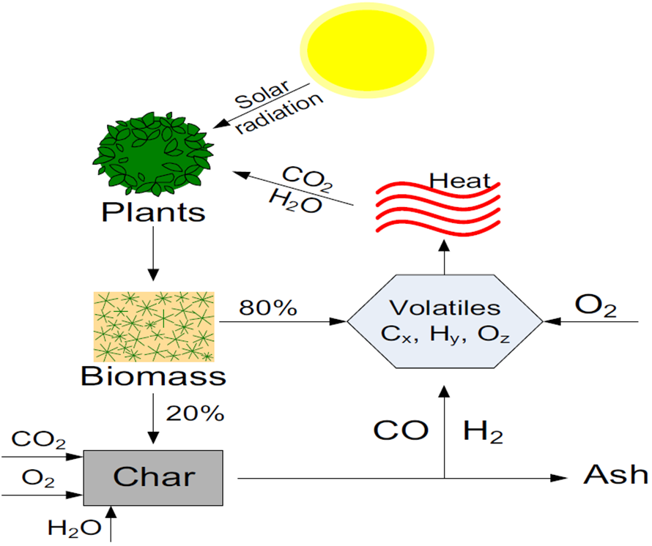
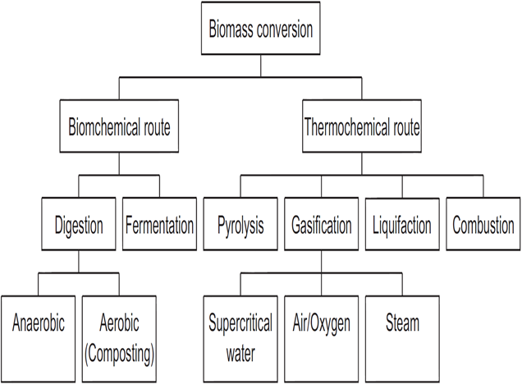
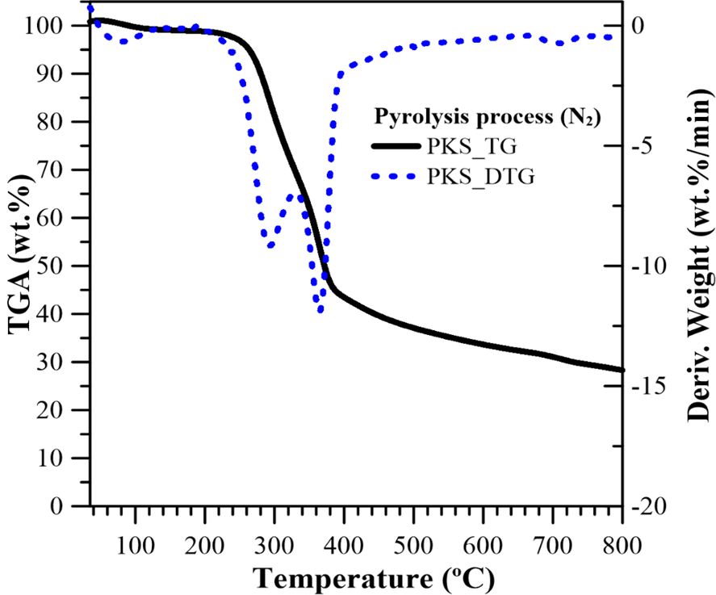
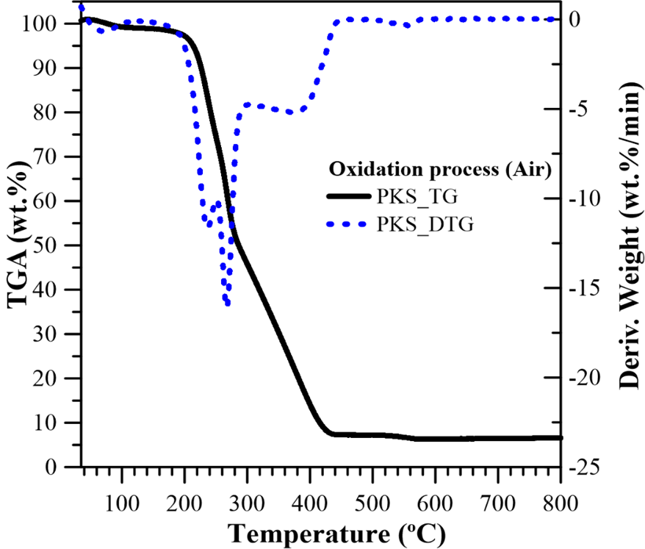
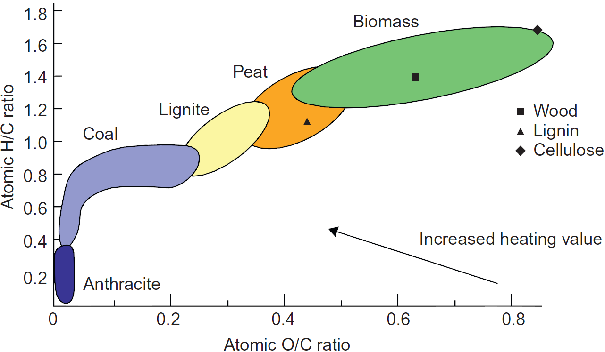
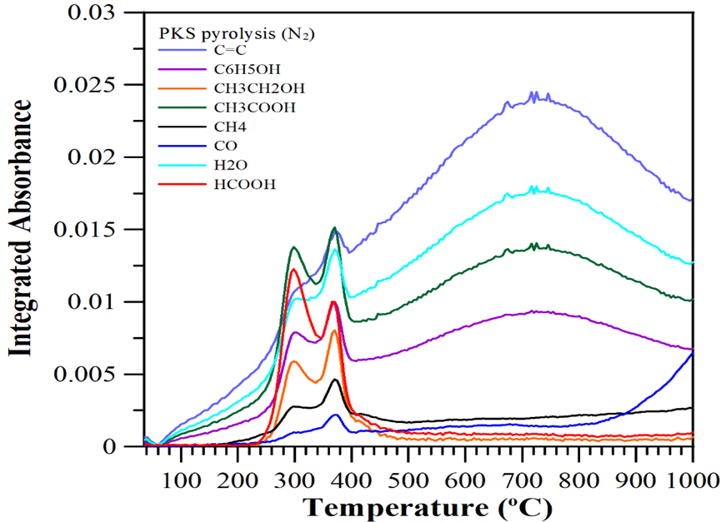
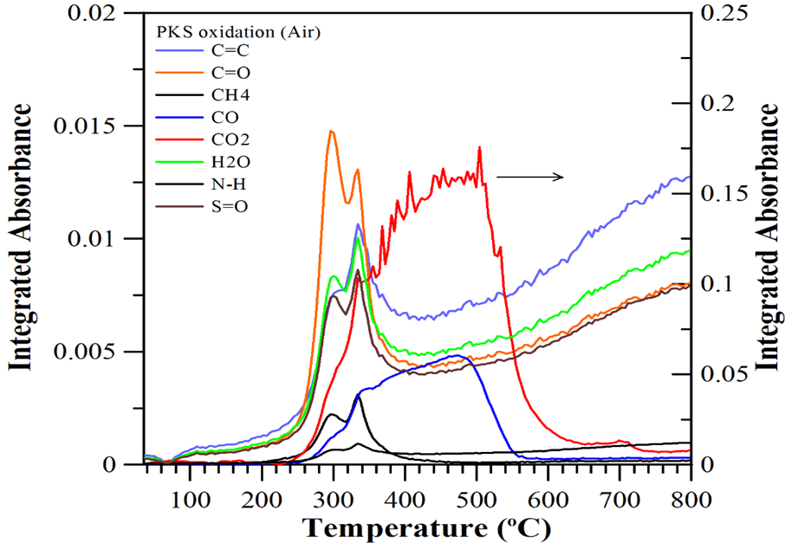
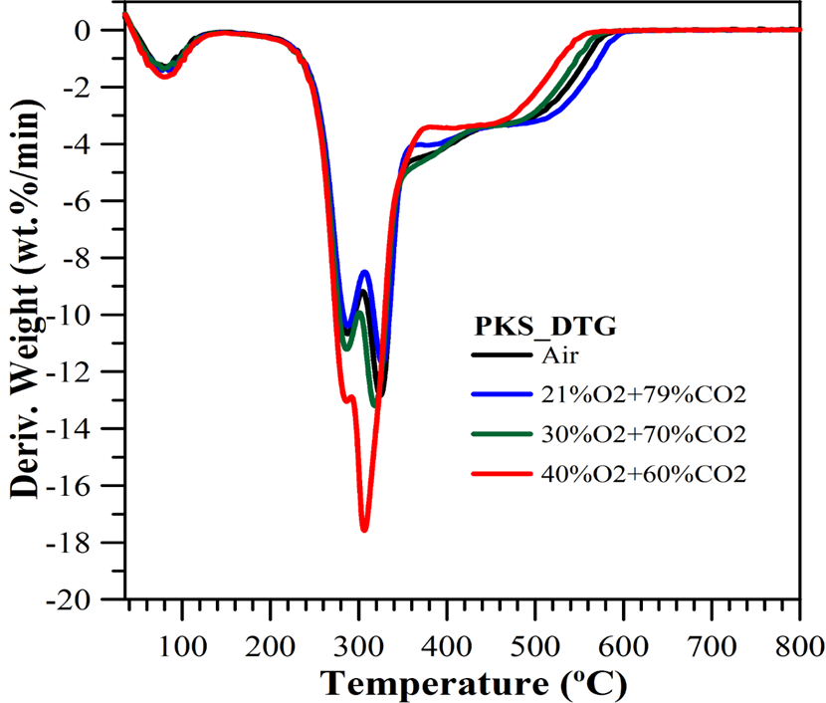
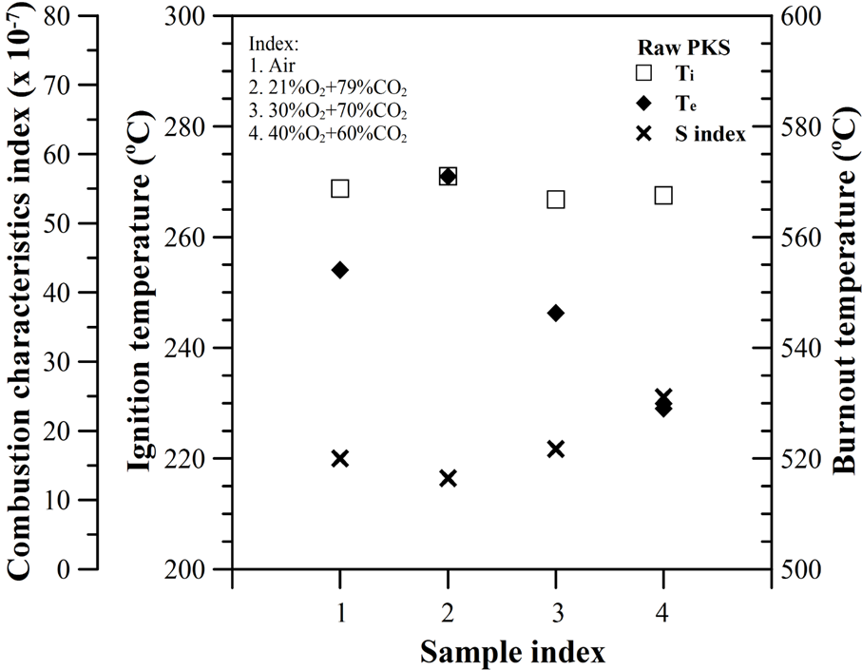
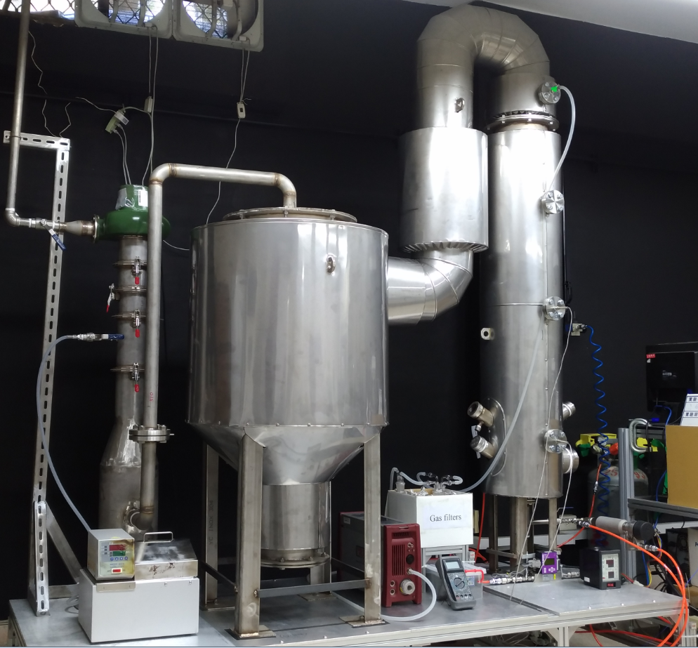
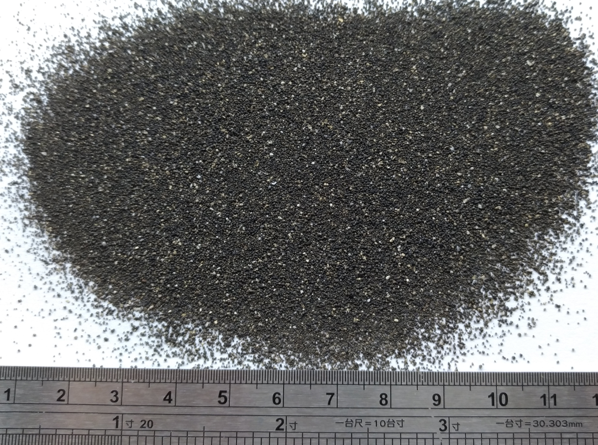
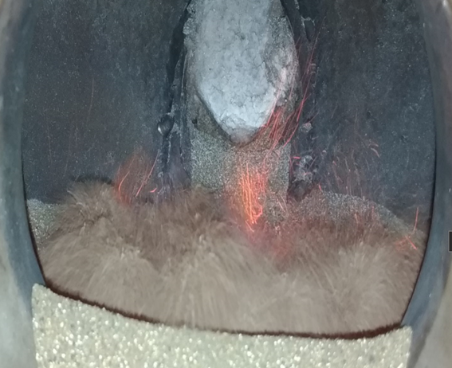
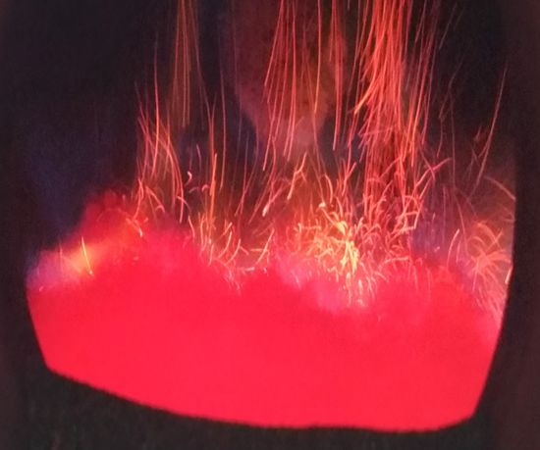
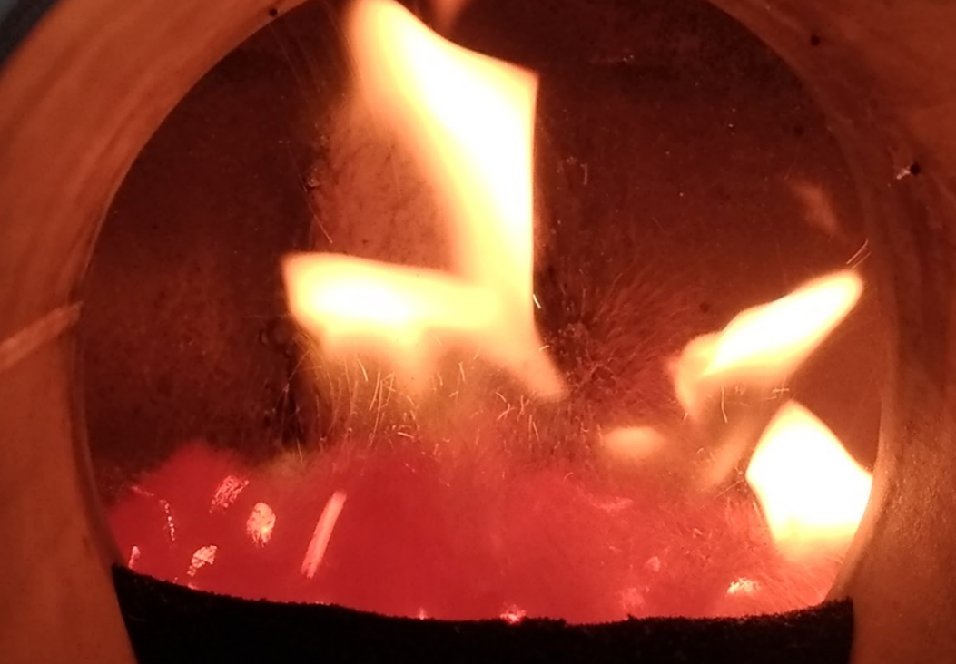
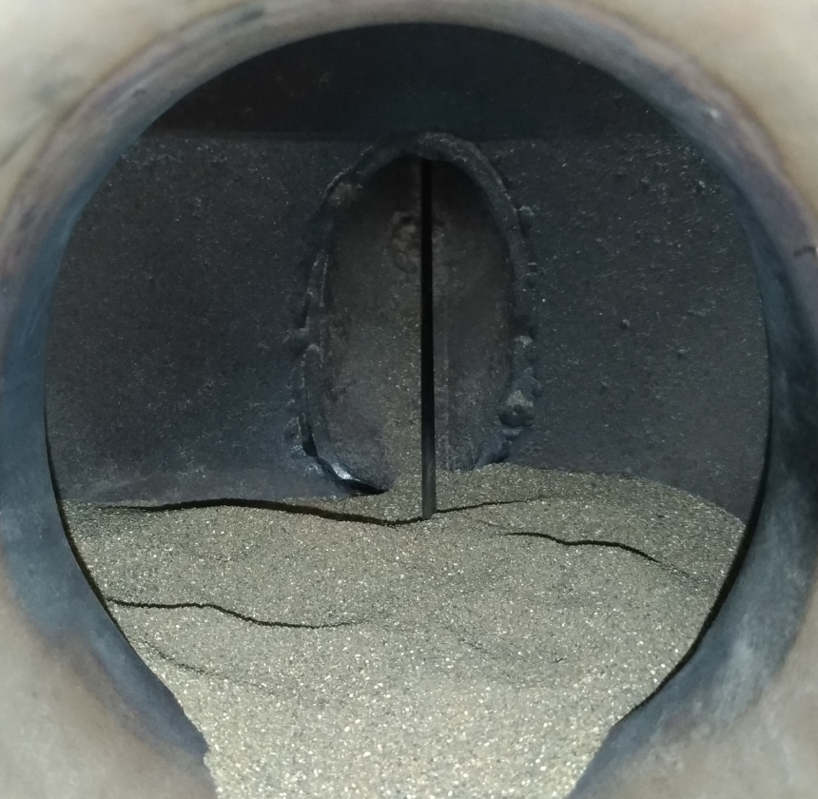
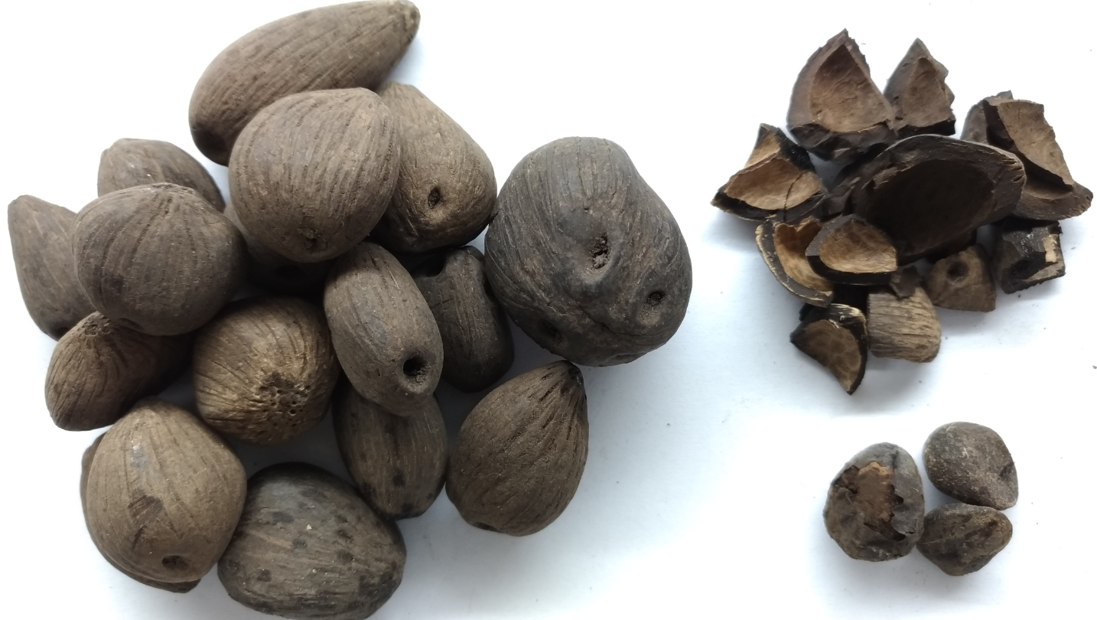
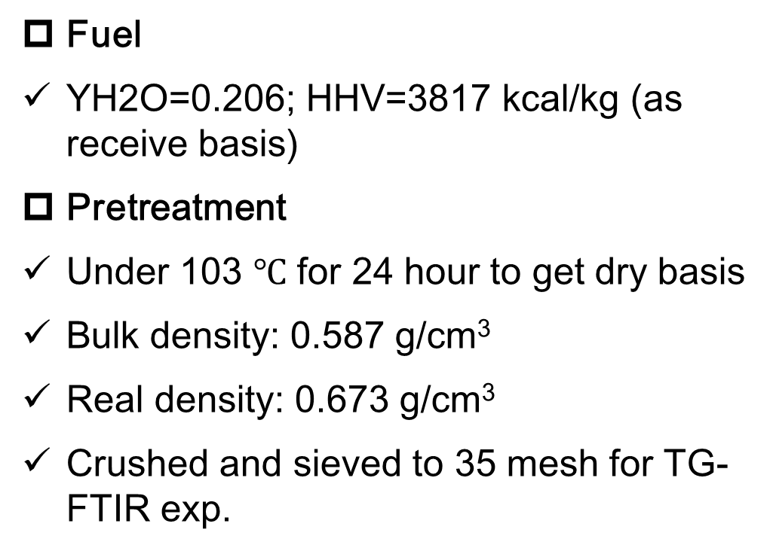
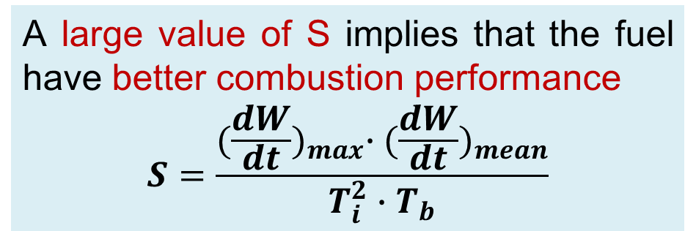
Lab-scale bubbling fluidized bed development and oxy-combustion validation
Tzu-Lu Fang,Hsien-Tsung Lin,Guan-Bang Chen,Yei-Chin Chao Chen Ming-Hsun Wu*
Department of Mechanical Engineering, National Cheng Kung University, Taiwan
*Contact email: minghwu@mail.ncku.edu.tw
Introduction
Fuel type | Proximate analysis (wt. % dry basis) |  |  | Elemental analysis (wt. % dry basis) |  |  |  |  | HHV (kcal/kg)
 | VM | FC | Ash | C | H | O | N | S
PKS | 79.65 | 14.56 | 5.79 | 49.8 | 6.05 | 42.64 | 0.66 | 0.06 | 4754
Coal | 33.66 | 46.3 | 20.0 | 73.3 | 4.17 | 5.25 | 1.44 | 0.52 | 6730
TG-FTIR analysis
Biomass combustion diagram and carbon cycle closed loop
Thermochemical route of biomass conversion
Van Krevelen diagram
O2/CO2 Recycle (Oxy-fuel) Combustion Capture
Research method
Fuel property analysis
Elemental, proximate, fiber and HHV analysis
Thermogravimetric analysis
FTIR
A large value of S implies that the fuel have better combustion performance
$$S=\frac{{(\frac{dW}{dt})}_{max}∙{(\frac{dW}{dt})}_{mean}}{T_{i}^{2}∙T_{b}}$$
Define Ti and Tb by intersection method and conversion method, respectively.
Experimental Setup
Conclusion
Bubbling fluidized bed
Gas flowmeter and preheater
Gas analyzer
Temperature measurement
Gas condenser
Bed material (gravel)
Size: 0.177-0.5 mm
Belong to Group B particle, The bed starts bubbling immediately after reaching U_{mf}
Interaction of LPG/Air flame with bed meterial
PKS combustion
BFB system
Dense bed
Fuel property analysis
Fuel
YH2O=0.206; HHV=3817 kcal/kg (as receive basis)
Pretreatment
Under 103 $℃$ for 24 hour to get dry basis
Bulk density: 0.587 g/cm³
Real density: 0.673 g/cm³
Crushed and sieved to 35 mesh for TG-FTIR exp.
Preheat
Batch feeding and study
The variation of dense bed temperature and downstream gas emission with time
Future work
Palm Kernel shell
PKS oxy-combustion validation in fluidized bed
PKS gasification study
Avoid slagging during operation

